Slide 1
Fairness in
ICU Mortality Prediction
Yun-Jing Chang, Liujia Yu

Slide 2
Data & Features
Demographics
Gender
age brackets (18–29, 30–49, etc.)
race categories (WHITE, BLACK, ASIAN, etc.)
Clinical Measurements
vital‐sign summaries (min/max/mean)
lab test counts and maxima
Outcome:
icu-mortality
94,444 ICU stays
115 features

Slide 3
Methods
Modeling & Threshold Selection
Fairness Diagnosis
Bias Mitigation Strategies

Slide 4
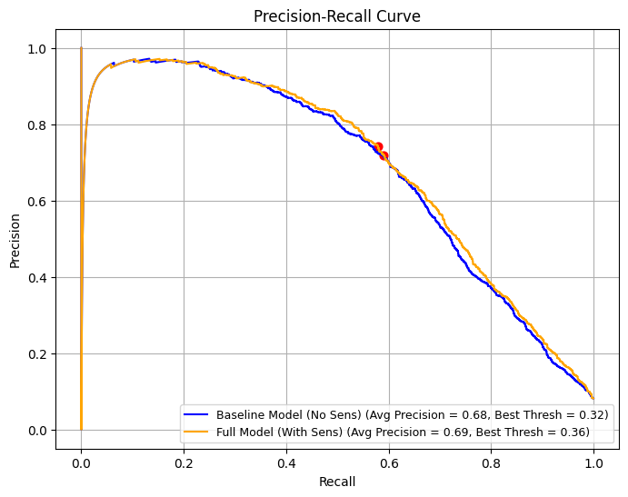
Modeling & Threshold Selection
Baseline Model (no sensitive features)
AUC: 0.912
Full Model (with gender, age, and race features)
AUC: 0.920
Baseline → 0.325
(Precision 0.72, Recall 0.59, F₁ 0.65)
Full → 0.356
(Precision 0.74, Recall 0.58, F₁ 0.65)

Slide 5
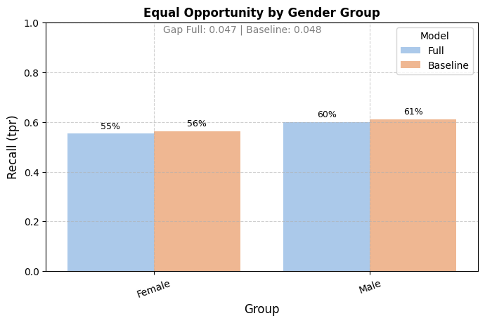
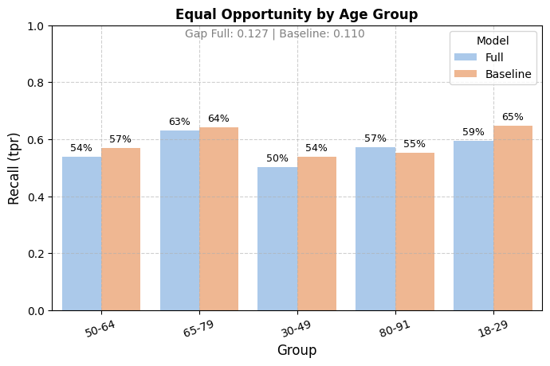
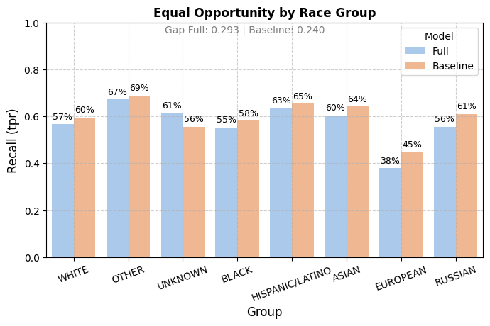
Fairness Diagnosis
Equal Opportunity (TPR/Recall)
Statistical Parity (Positive Prediction Rate)
Equalized Odds (TPR & FPR)
Calibration (Reliability of predicted probabilities)

Slide 6
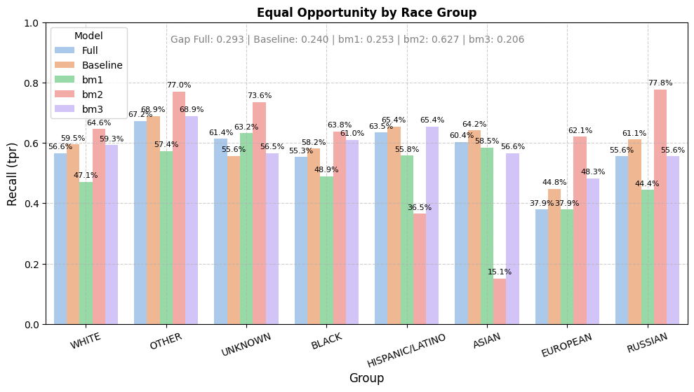
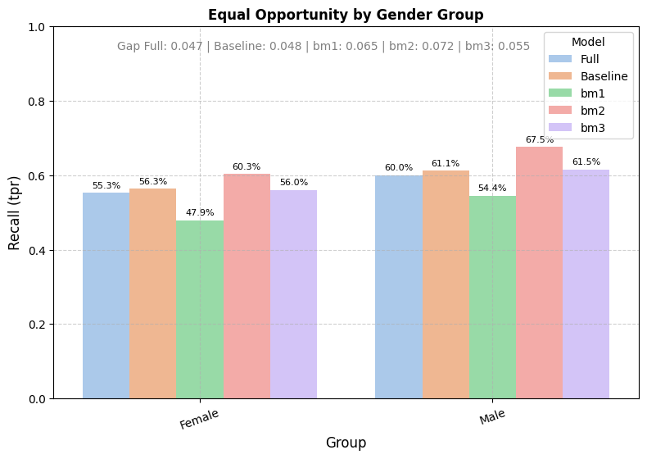
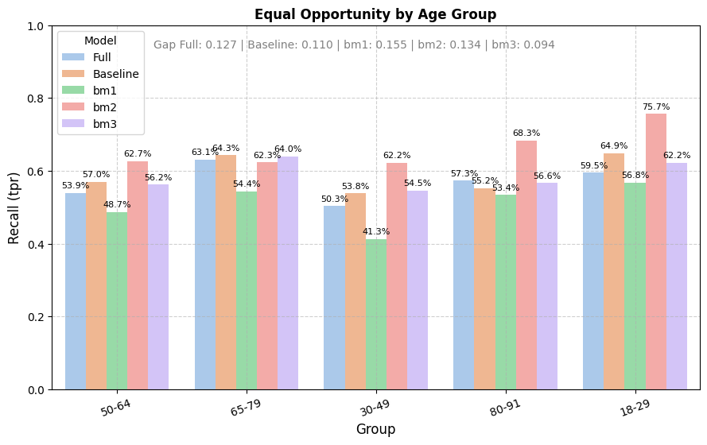
Bias Mitigation Strategies
SMOTE + Reweighting
🔺 recall for the minority class (79%)
🔻 precision (31%) and AUC to 0.898
SMOTE + Regularization
⛳️ similar recall (80%)
⛳️ slightly better precision (33%), AUC 0.876
SMOTE + Adversarial Debiasing
🔺 highest recall (88%)
⛳️ moderate precision (26%) and AUC 0.916

Slide 7
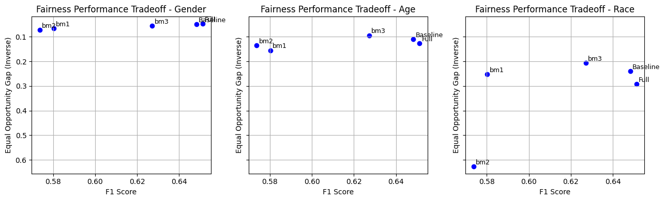
Conclusions
Next step…
XGBoost and MLP

